Slide 1

🟦 HMEQ Loan Default Risk Analysis
End-to-End Analytics Project
Tools: SQL | Python | Excel
Domain: Banking / Credit Risk
Objective: Analyze loan default behavior and convert insights into actionable credit policy decisions.

Slide 2
🟦 Business Problem
Business Problem
Financial institutions issuing home equity loans face challenges in:
Identifying borrowers likely to default
Avoiding overly strict approval rules
Understanding whether risk is concentrated or portfolio-wide
Key Question: How can data be used to reduce defaults without hurting approvals?

Slide 3
🟦 Dataset Overview
Dataset: HMEQ (Home Equity Loans)
Key Features:
Data Characteristics:
Loan & collateral: LOAN, VALUE, MORTDUE
Imbalanced target
Borrower risk: DEBTINC, CLNO, YOJ
Missing values
Credit history: DELINQ, DEROG, NINQ
Skewed financial distributions
Target: BAD (1 = Default, 0 = No Default)

Slide 4

🟦 Project Workflow
End-to-End Workflow
01
02
03
Dashboard Analysis
SQL Analysis
Python Modeling
Portfolio overview
Business logic
Predictive risk modeling
Risk distribution
Threshold detection
Feature importance validation
Policy simulation
Goal: Move from descriptive reporting to decision-oriented insights.

Slide 5
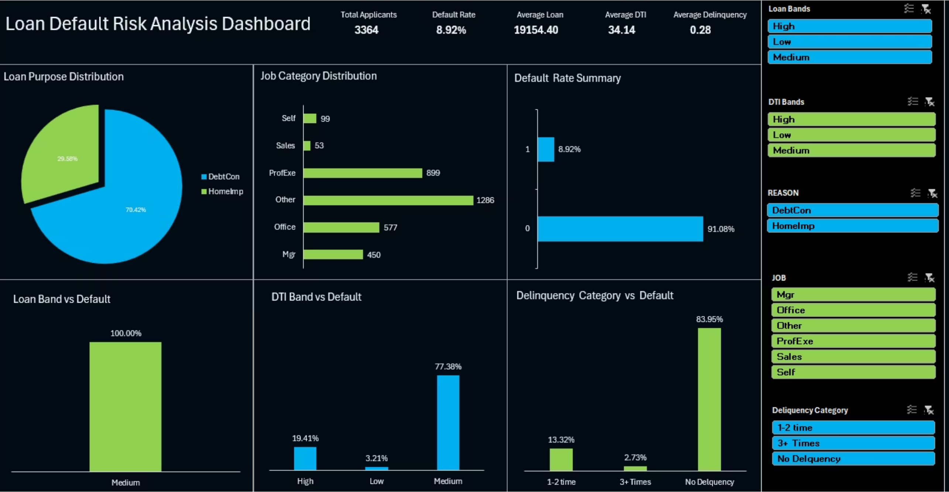
🟦 Dashboard Insights
Dashboard-Level Insights
Overall default rate is below 10% → moderately healthy portfolio
Majority of loans are Debt Consolidation
Most defaults come from medium-risk segments, not extreme cases
Large share of defaults occurs without prior delinquency history

Slide 6

🟦 SQL Insight 1: Multi-Factor Risk
Combined Risk Impact (SQL Analysis)
Finding:
Borrowers with High DTI + Delinquency + High Inquiries
Other borrowers
8.2%
46.5%
Default Rate
Default Rate
Insight: Risk factors compound strongly when they occur together.
Business Implication: These profiles should trigger automatic rejection or stricter pricing.

Slide 7
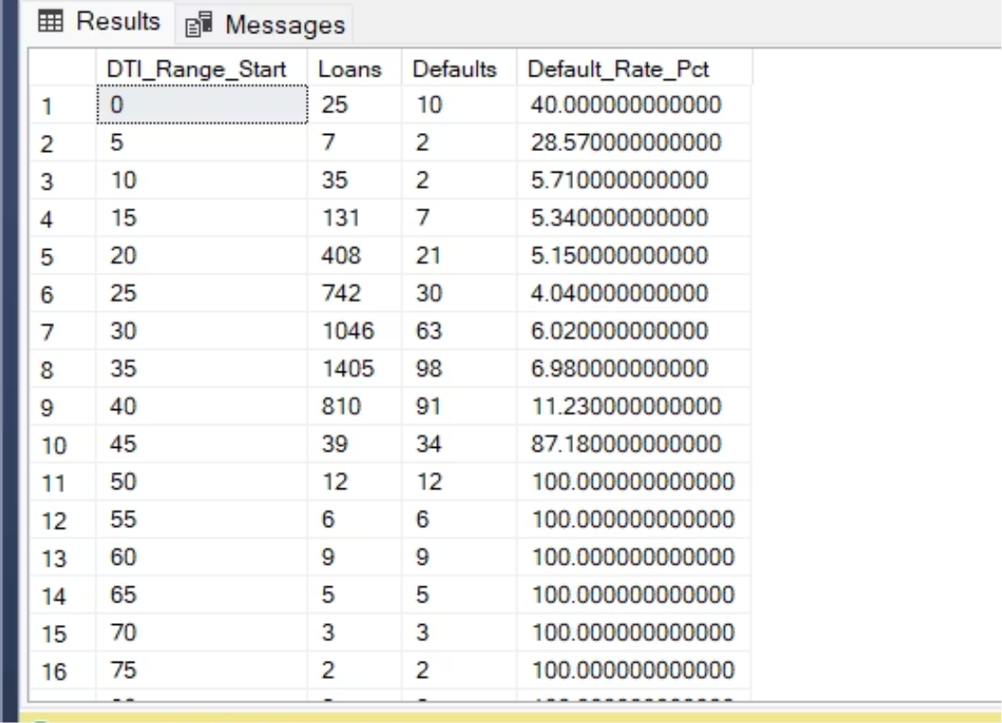
🟦 SQL Insight 2: Policy Thresholds
DTI Threshold & Policy Simulation
DTI Analysis:
What-If Policy Simulation:
Default risk increases sharply beyond ~40% DTI
Reject loans with DTI > 40 and prior delinquency
59 historical defaults could have been prevented
Business Implication: Small rule changes can deliver meaningful loss reduction.

Slide 8
🟦 SQL Insight 3: Portfolio Risk
Default Concentration (Pareto Analysis)
Finding:
Defaults are not highly concentrated
Business Implication: Loss reduction requires portfolio-wide policy improvements, not only targeting outliers.
No strong 80/20 pattern observed
Insight:
Default risk is spread across the portfolio, not isolated to a few borrowers.

Slide 9




🟦 Python Modeling Insights
Predictive Modeling (Python)
Approach:
Handled missing values using median imputation
Used tree-based model to capture non-linear risk
Evaluated using Recall & ROC-AUC, not accuracy
Key Risk Drivers Identified:
Debt-to-Income Ratio (DEBTINC)
Delinquency History (DELINQ)
Credit Exposure (CLNO)
Employment Stability (YOJ)
Insight: Model behavior aligns with financial risk logic.

Slide 10

🟦 Final Takeaways
Key Business Takeaways
Most defaults come from moderate-risk, high-volume segments
Risk accelerates beyond clear thresholds (DTI ~40%)
Combining risk signals is more powerful than single indicators
Portfolio-wide policy tuning is more effective than extreme filtering
Conclusion: This project demonstrates how SQL, Python, and dashboards together can support real credit risk decisions, not just reporting.

